Slide 1
Schematic

Slide 2
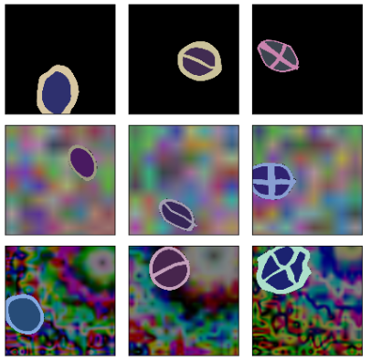
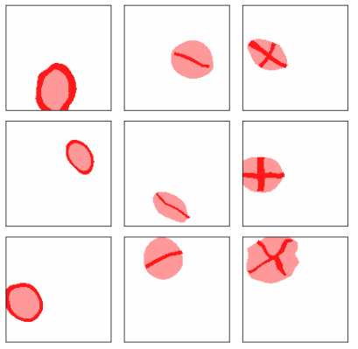
Workflow 1: data preparation
Part 1
Part 2
Part 3
Training Phase
XAI and Evaluation
DATA PREP
Data is loaded as pytorch Dataset:
class TenClassesPyIO() (pipeline.objgen. random_simple _gen_implemented.py)
create_or_load _data_shards() runs either 1. save_one_shard() or 2. save_one_chunk() n_shard times.
there is a misnomer in the method name. Data is not actually loaded here.
(pipeline. data. prepare _10classes _data.py)
This function creates as many shards as specified by the argument n_shard. The argument n_per_shard specifies how many images are stored in a single shard.
Data will be loaded shard by shard during training phase.
Class
inheritance
class TenClassesRandomFetcher () (pipeline.objgen. random_simple_ gen_implemented.py)
draw_one_sample(y0, bg_rand)
return cobj, cimg , heatmap , variables
Define class that implements the method that returns the image, cimg
Individual methods to construct image and heatmaps. Basic format
{
1. Get settings (translation, rotation, shapes, colors)
2. Initiate object, cobj (one object is defined per class)
3. Make core items: image cimg and heatmaps heatmap.
4. Collate settings into variables
}
CCell () (pipeline objgen. cells.py)
build_basic_ball_body()
return ball, heatmap
*ball is cimg
class Simple RandomFetcher () (pipeline.objgen. random_simple _generator.py)
get _random _CCellX ()
get _random_CCellMX()
get _random_CCellPX()
…
get _random_CCellTX8()
Define class that implements make _explanation() ,which returns the image, heatmap
y0=0, bg_rand=1
y0=2, bg_rand=1
y0=0, bg_rand=0
y0=1, bg_rand=0
y0=0, bg_rand=0
y0=1, bg_rand=0
CCellX ()
CCellMX()
CCellPX()
…
CCellTX8()
CCell () (pipeline objgen. ccells.py)
build_ccell_body()
return ball, heatmap
*ball is cimg
ObjetOutline2D () (pipeline. objgen. baseclass.py)
make_explanation()
return heatmaps
similar
similar
Available y0=0,1,…,9, bg_rand=0,1,2

Slide 3
Workflow 1: resnet34 description
Part 1
Part 2
Part 3
Part 3.3
Part 1.2
Part 2.2
Part 3.2
Training
Mode: Continuous
Plot loss
Training
Mode: regular evaluation
Validation
On validation dataset
Selection
XAI Methods
Mode: Saliency etc
Testing
Accuracy on test dataset
Unpack XAI results
DATA PREP
ROC AUC
View Gallery
Data is loaded shard by shard within each training epoch.
Plot losses against iterations in [model-name].jpg
If .optim exists, proceed with it. Otherwise, if the desired performance is not reached, .noptim is created. We can proceed with .noptim instead.
Run the process that computes the score for XAI evaluation and save it as .xai data.
Along the way, computes classification accuracies on testing dataset.
XAI evaluation data stored in .xai is arranged into .csv file that is ready for analysis
Training a model by fine-tuning pretrained resnet34 to the new dataset. [model-name].model. Info is stored in [model-name] .info
Training with validation on a fraction of validation dataset (for efficiency), followed by full validation on validation dataset.
For each branch of model and each XAI method used, create a gallery that displays the resulting heatmaps
The fine-tuned model is trained further. Many branch models [model-name]. [branch no.].model are created from it. This is for validation to ensure that a good performance does not just happen by chance.
Full validation on validation dataset. Save a txt as a report and an .info file.
Pytorch captum API is used to compute attributions
The first evaluation metric we test is called the soft fiveband score
EvaluationPackage object is used to store the results from 2 and creates a gallery for viewing heatmaps from 1 (we select a few images to store, to prevent memory overload)
Main controller methods help with unpacking and plotting of intermediate results.

Slide 4
Workflow 1: resnet34 (methods-view)
Part 1
Part 2
Part 3
Part 3.3
Part 1.2
Part 2.2
Part 3.2
Training
Mode: Continuous
Plot loss
Training
Mode: regular evaluation
Validation
On validation dataset
Selection
XAI Methods
Mode: Saliency etc
Testing
Accuracy on test dataset
Unpack XAI results
DATA PREP
ROC AUC
View Gallery
load_dataset _from _a_shard()
(pipeline .data .prepare _10classes _data)
Output: [model-name].jpg
Methods: eval_resnet34 _ten_classes _plot_loss()
(pipeline. eval . resnet34_ ten_classes _eval)
Output:
1. [model-name]. [BRANCH NO]_ [xai_mode] .xai
2. [model-name]. [BRANCH NO]_ [xai_mode] .xai.txt
* Branch no. is optional
Methods:
eval_resnet34_ ten_classes_xai() (pipeline. eval. resnet34_ ten_classes _eval).
It uses modules from (pipeline. eval .evaluation_ xai _implementation), evaluation _ten _classes() which calls aggregate _evaluation()
Output:
[model-name]. [BRANCH NO]_ [xai_mode] .csv
* Branch no. is optional
Methods:
unpack_and_ pointwise_process _xai_data() (pipeline. eval. resnet34_ ten_classes_eval _unpack_ xai_data)
Output:
[model-name].[BRANCH NO].model.noptim
* If .model.optim is not obtained
Methods:
None
Output:
[model-name].model
[model-name].info
Methods:
1. training_resnet34 _ten_classes()
(pipeline. training .resnet34_ten_classes)
Methods:
1. training_resnet34 _ten_classes()
(pipeline. training. Resnet34 _ten_classes)
2. eval_resnet34 _ten_classes _branch _validation _info() (pipeline. eval. Resnet34 _ten _classes _eval)
Output:
folder gallery_[model-name]. [BRANCH NO]_ [xai_mode]
* Branch no. is optional
Methods:
1. calling view_gallery() (pipeline. eval. resnet34_ ten_classes_eval _unpack_ xai_data)
Output:
1. [model-name].[BRANCH NO].model
2. [model-name].[BRANCH NO].model.optim*
* In the best-case scenario, when target accuracy is reached.
Regular Evaluator() object (pipeline. training. Validation _utils) calling method evaluate _and _save()
Output:
1. [model-name].[BRANCH NO].txt
2. [model-name].[BRANCH NO].info
Method calls branch _validation _info() (pipeline.training.validation_utils)
Dependencies of aggregate _evaluation()
compute_single_data _attribution() (pipeline. eval. evaluation _xai _utils)
soft_fiveband_score() (pipeline. eval. eval_metrics)
EvaluationPackage() object. (pipeline. eval. Evaluation _xai _utils)
Calls add_xai_data_by_xai_method()
Calls add_xai_output_to_gallery_by_groundtruth()
Dependencies
Main modules from (eval _unpack_ xai_data)
1. view_gallery _control()
2. unpack_and _pointwise _process _xai_data _control()

Slide 5
Workflow 3: VGG (methods-view)
Workflow 2: AlexNet (methods-view)
Part 1
Part 2
Part 3
Part 3.3
Part 1.2
Part 2.2
Part 3.2
Training
Mode: Continuous
Plot loss
Training
Mode: regular evaluation
Validation
On validation dataset
Selection
XAI Methods
Mode: Saliency etc
Testing
Accuracy on test dataset
Unpack XAI results
DATA PREP
ROC AUC
View Gallery
Part 1
Part 2
Part 3
Part 3.3
Part 1.2
Part 2.2
Part 3.2
Training
Mode: Continuous
Plot loss
Training
Mode: regular evaluation
Validation
On validation dataset
Selection
XAI Methods
Mode: Saliency etc
Testing
Accuracy on test dataset
Unpack XAI results
DATA PREP
ROC AUC
View Gallery

Slide 6
 |  | Resnet | Alexnet | VGG
 | Batch size | 4 | 16 | 16
TC | epoch | 2 | 16 | 4
TR | epoch | 4 | 16 | 4
Acc on eval | Branch 1 | 0.947 | 0.980 | 0.980
 | Branch 2 | 0.946 | 0.981 | 0.971
 | Branch 3 | 0.954 | 0.980 | 0.990
 | Branch 4 | 0.947 | 0.985 | 0.993
 | Branch 5 | 0.961 | 0.980 | 0.995
 | Average | 0.951 | 0.9812 | 0.9858
Set using config_data[‘n_epoch’], N_CONTINUOUS _TRANING_EPOCH
Set using config_data[‘n_epoch’], N_REGULAR_EVALUATION_EPOCH
eval_every_n_iter=4

Slide 7
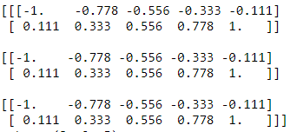

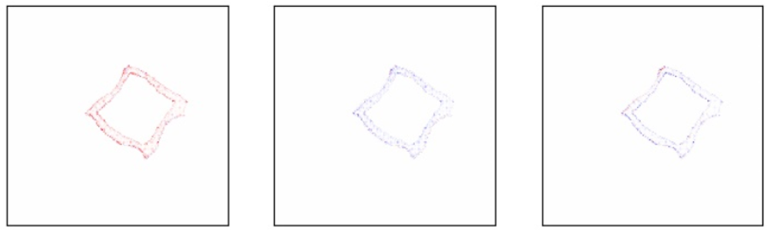
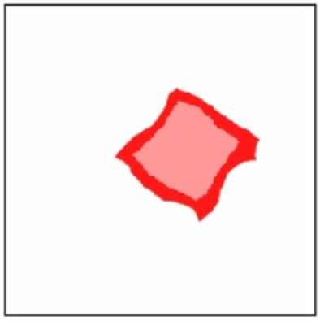



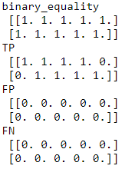
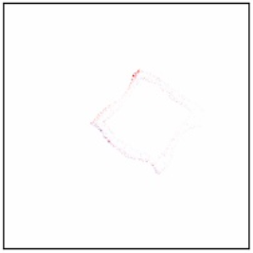
Five-band Score
pipeline. eval. eval_metrics/ eval_metrics.py FiveBandXAIMetric()
Example 1
def fiveband_score (self, h, h0, setting=None, verbose=0):
h0
h
h
Attribution computed by XAI method from pytorch captum
shape: (C,H,W)
h0
Groundtruth attribution that we define in pipeline. objgen
shape: (H,W)
For example, C=3 (three channels):
For example:
sum _pixels_ over _channels()
Channel 1: R
Channel 2: G
Channel 3: B
Collapse into one channel, for example by sum _pixels_ over _channels()
'pixel_acc': 1.0,
'recall': 0.999,
'precision': 0.999
h (stratified)
Array of shape (H,W) containing only 5 bands, i.e. its entry only has [-2,-1,0,1,2]
h0 (stratified)
Array of shape (H,W) containing only 5 bands, i.e. its entry only has [-2,-1,0,1,2]
After counting the number of 1s in TP, FP etc
Recall = TP/(TP + FN + e)
Precision = TP/(TP + FP + e)
e is a small number to prevent division by zero
Compute binary accuracy, recall, precision
Five band stratification
This process requires threshold settings, for example the default [-0.7, -0.3, 0.3, 0.7].
Assuming that the array we stratify is normalized to [-1,1], the entry by entry conversion is shown below.
-0.7 -0.3 0.3 0.7
-2 -1 0 1 2

Slide 8
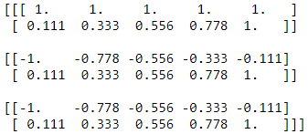



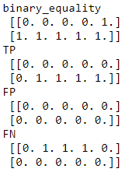
Example 2
h0
h
sum _pixels_ over _channels()
'pixel_acc': 0.6,
'recall': 0.57143,
'precision': 0.9999
TP (true positive): here it is slightly different
For TP to be 1, h0 must be non-zero and h must be correct. So if h0[i,j]=2 but h[i,j]=1, it is not a true positive
After counting the number of 1s in TP, FP etc
Recall = TP/(TP + FN + e)
Precision = TP/(TP + FP + e)
e is a small number to prevent division by zero

Slide 9
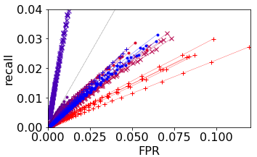
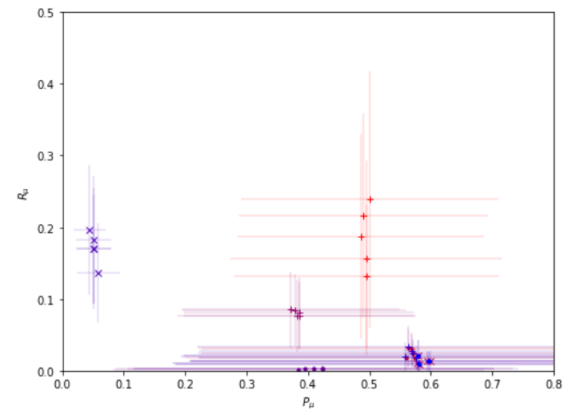




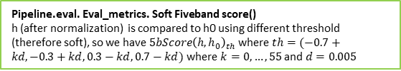





pipeline.eval. evaluation_xai_implementation. Aggregate evaluation()
Sample by sample
Attribution h is computed for the predicted value (NOT the correct value)
As shown in the following code:
attr = attrmodel.attribute(x1[0:0+1], target=y_pred)
metrics_collection
metrics 1
metrics 2
metrics $n_{soft delta}$
$$t_{1}$$
$$t_{\left(n_{soft delta}\right)}$$
${t0}_{1}$, acc (A) , recall (R), precision (P), FPR
…
Return
Pipeline.eval. Eval_metrics. Soft Fiveband score()
h (after normalization) is compared to h0 using different threshold (therefore soft), so we have $5bScore{\left(h,h_{0}\right)}_{th}$ where $th=(−0.7+kd,−0.3+kd,0.3−kd,0.7−kd)$ where $k=0,…,55$ and $d=0.005$
$t_{m}$ is the m-th threshold
$t0_{m}$ is the m-th threshold for groundtruth, mostly not a problem
 | id | y0 | y_pred | pred_is _correct | Amu | Au | Au1 | Rmu | Ru | Ru1 | Pmu | Pu | Pu1
0 | small_test_data_10c_chunk1_queue0 | 5 | 4 | 0 | 0.936373 | 0.939573 | 0 | 0.00024 | 0.00034 | 6 | 0.004184 | 0.011236 | 2
1 | small_test_data_10c_chunk1_queue1 | 8 | 4 | 0 | 0.894275 | 0.896046 | 6 | 0.012019 | 0.031746 | 6 | 0.983644 | 1 | 3
2 | small_test_data_10c_chunk1_queue2 | 1 | 4 | 0 | 0.929688 | 0.932697 | 0 | 0.01655 | 0.04556 | 6 | 0.316526 | 0.5 | 0
3 | small_test_data_10c_chunk1_queue3 | 2 | 4 | 0 | 0.830015 | 0.832091 | 6 | 0.006286 | 0.023408 | 6 | 0.927155 | 1 | 2
4 | small_test_data_10c_chunk1_queue4 | 8 | 8 | 1 | 0.895793 | 0.897202 | 6 | 0.013577 | 0.034424 | 6 | 0.956411 | 1 | 3
5 | small_test_data_10c_chunk1_queue5 | 8 | 6 | 0 | 0.903693 | 0.905194 | 6 | 0.033136 | 0.066697 | 6 | 0.899513 | 0.965517 | 0
6 | small_test_data_10c_chunk1_queue6 | 7 | 0 | 0 | 0.913112 | 0.915378 | 6 | 0.027842 | 0.063004 | 6 | 0.96769 | 1 | 2
7 | small_test_data_10c_chunk1_queue7 | 2 | 2 | 1 | 0.888735 | 0.890047 | 6 | 0.007792 | 0.026266 | 6 | 0.885367 | 0.999999 | 0
8 | small_test_data_10c_chunk1_queue8 | 6 | 0 | 0 | 0.873223 | 0.876893 | 6 | 0.021429 | 0.051988 | 6 | 0.997623 | 1 | 4
Threshold by threshold
Sample by sample
$$(<FPR>,<R>)$$
i.e. Mean values over all samples per threshold
Recall, FPR
An example from workflow2_0001\workflow2_0001.1
\XAI_results\workflow2_0001.1_InputXGradient.clamp.csv
$(E\left[P_{μ}^{\left(k\right)}\right]$, $E\left[R_{μ}^{\left(k\right)}\right]$)
$$\sqrt{Var\left[P_{μ}^{\left(k\right)}\right]}$$
$$\sqrt{Var\left[R_{μ}^{\left(k\right)}\right]}$$
1 XAI type, 1 mode branch

